Slide 1
Fertilizers Recommendation For fruits Disease Prediction
GUIDED BY SUBMITTED BY
Devika M Jyothisri P (420419104024)
(Assistant professor /CSE) Kalaivani A (420419104025)
Gajalaxmi S (420419104019)

Slide 2
Agenda
Abstract
Introduction
Literature Review
Analysis of Literature Review
Objectives
Problem Statement
YOLO Algorithm
Architecture diagram
Modules
Conclusion

Slide 3
Abstract
The system uses deep learning techniques to detect and classify fruits diseases from images and recommends fertilizers based on the disease detected.
Trained on a large dataset of fruits disease images, achieving high accuracy in disease detection.
The proposed system can help farmers in making informed decisions on fertilizers to use for their fruits and reduced losses due to disease.

Slide 4
Introduction
Fertilizer recommendation and fruit disease prediction are two important aspects of modern agriculture. Fertilizer recommendation involves providing guidance on the type and amount of fertilizers that should be applied to crops to maximize yield and quality.
This involves considering factors such as the type of soil, the type of crop being grown, and the stage of growth. Fertilizer recommendations can be based on soil testing, plant tissue analysis, or other methods.

Slide 5
Continue...
Fruit disease prediction involves using data and technology to forecast the likehood of disease outbreaks in fruit crops. This can include monitoring weather conditions, pest populations, and other factors that can contribute to disease development.
By predicting disease outbreaks, farmers can take proactive measures to prevent or mitigate the impact of the disease on their crops. Both fertilizer recommendation and fruit disease prediction are important tools for modern farmers, helping them to optimize their crop yields and ensure the health and quality of their produce.

Slide 6
Literature Review
PAPER NAME: Nithya, P. "Fertilizers recommendation system for disease prediction in tree leave." International Journal of Scientific and Technology Research 8, no. 11 (2019): 3343-3346.
PAPER DESCRIPTION :
Finding the leaf disease is an important role of agriculture preservation. After pre-processing using a median filter, segmentation is done by Guided Active Contour method and finally, the leaf diseaseis identified by using Support Vector Machine. The disease-based similarity measure is used for fertilizer recommendation.

Slide 7
Continue...
PAPER NAME: Anjanadevi, B., I. Charmila, N. S. Akhil, and R. Anusha. "An improved deep learning model for plant disease detection." International Journal of Recent Technology and Engineering 8, no. 6 (2020): 5389-5392.
PAPER DESCRIPTION :
Agriculture is one of major living source in India. To increase the yield by preventing diseases and detection of diseases place major role in agriculture domain. By using Improved and customized DCNN model (improved-detect),We trained plantdoc and plant village datasets. we have experimented on plant image data set-tomato leaves both healthy and diseased ones.

Slide 8
Continue...
PAPER NAME: Venkatesh, Ede, G. Elizabeth Rani, Balasaraswathi Yugandher, Adiki Nithin Kumar, and Karnam Balaji. "An automated prediction of crop and fertilizer disease using Convolutional Neural Networks (CNN) 2020."
PAPER DESCRIPTION :
The OpenWeather API is used to get the live temperature and humidity of the respective locations and we need to enter the soil nutrition values to get a better crop recommendation. We have used Resnet architecture for leaf disease prediction.

Slide 9
ANALYSIS OF LITERATURE REVIEW
Paper Name | YEAR | MERITS | DEMERITS
Fertilizers recommendation system for disease prediction in tree leave | 2019 | F-Measure for CNN is 0.7and 0.8 for SVM, the accuracy of identification of leaf disease of CNN is 0.6 and SVM is 0.8 | Various segmentation algorithms can be implemented to improve accuracy.
An improved deep learning model for plant disease detection | 2020 | The CNN has achieved an accuracy of 95.48. Used model has high rate along with better recognition of diseases. | Images in the dataset are very less.Train a dataset for at long time.
An automated prediction of crop and fertilizer disease using Convolutional Neural Networks (CNN). | 2020 | Best accuracy of 99.09% other models who have done the crop recommendation have the accuracy in the range between 92 to 96%. | More time to take for train the dataset.We should feed n number of dataset for traing process.

Slide 10
Objectives
To improve fruit health and yield by detecting and addressing nutrient deficiencies and other factors that contribute to the onset of plant diseases.
This can be accomplished through the following specific objectives:Disease detection,Nutrient assessment,Fertilizer recommendation.

Slide 11
Problem Statement
STATEMENT 1
To Collect a dataset of images of healthy and diseased fruits .
STATEMENT 2
To use the collected dataset to train a YOLOv5 model for detecting fruits diseases in images.
STATEMENT 3
To develop a fertilizer recommendation system.

Slide 12
YOLO (You Only Look Once) Algorithm
YOLO is a popular object detection algorithm that uses a single neural network to predict multiple bounding boxes and class probabilities in an image.
It can be trained on a large dataset of annotated images to recognize different objects and their locations within an image.
To use YOLO for fertilizers recommendation and disease prediction, the drone would need to capture images of the fruits from different angles and heights.

Slide 13
Continue...
These images would then be fed into a YOLO model that has been trained on a dataset of annotated fruits images.
The YOLO model would be able to detect and identify different fruits features, such as fruits color, texture, and shape, and use this information to make recommendations for the appropriate type and amount of fertilizer to apply.

Slide 14
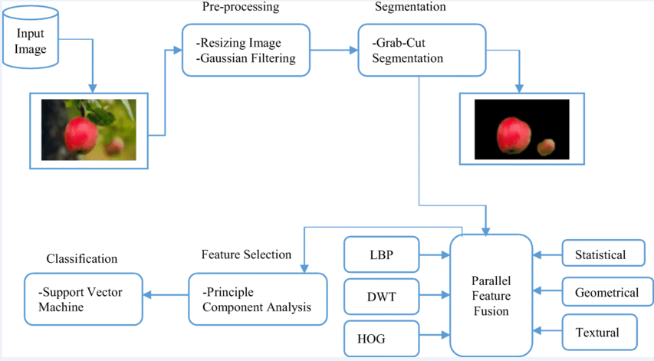
Architecture diagram

Slide 15
Modules
Module -1 :
Data Collection
Data Preprocessing
Module - 2 :
Training
Evaluation
Testing
Module - 3 :
Fertilizer Recommendation

Slide 16
Module - 1
Data Collection: The first step is to collect a large dataset of images of healthy and diseased fruits.
Data Preprocessing: The collected images need to be preprocessed to enhance the quality and improve the model's accuracy.

Slide 17
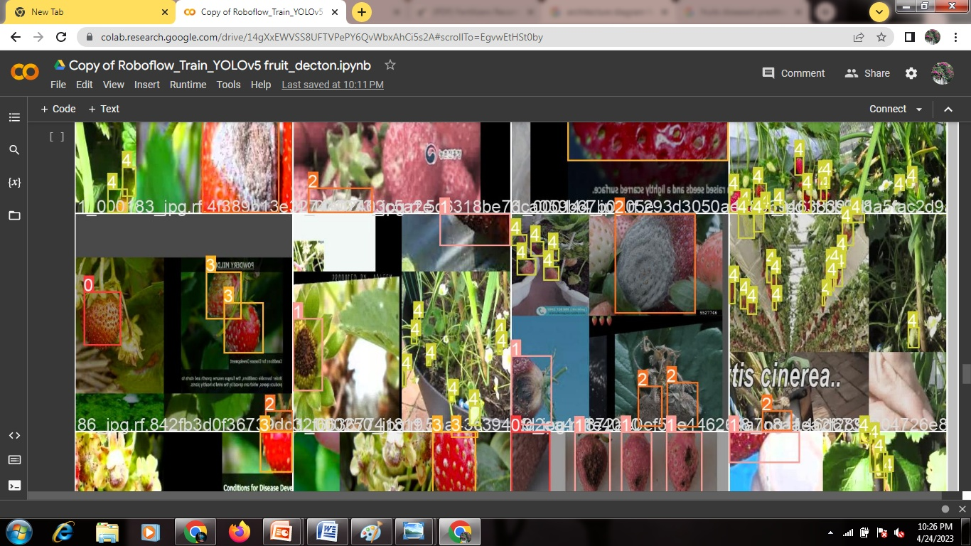
Module - 2
Training: The next step is to train the YOLOv5 model using the annotated dataset. During training, the model learns to detect and classify the different types of fruits diseases.
Annotation process

Slide 18
Continue...
Evaluation: After training, the model needs to be evaluated using a separate validation dataset to check its accuracy and performance.

Slide 19
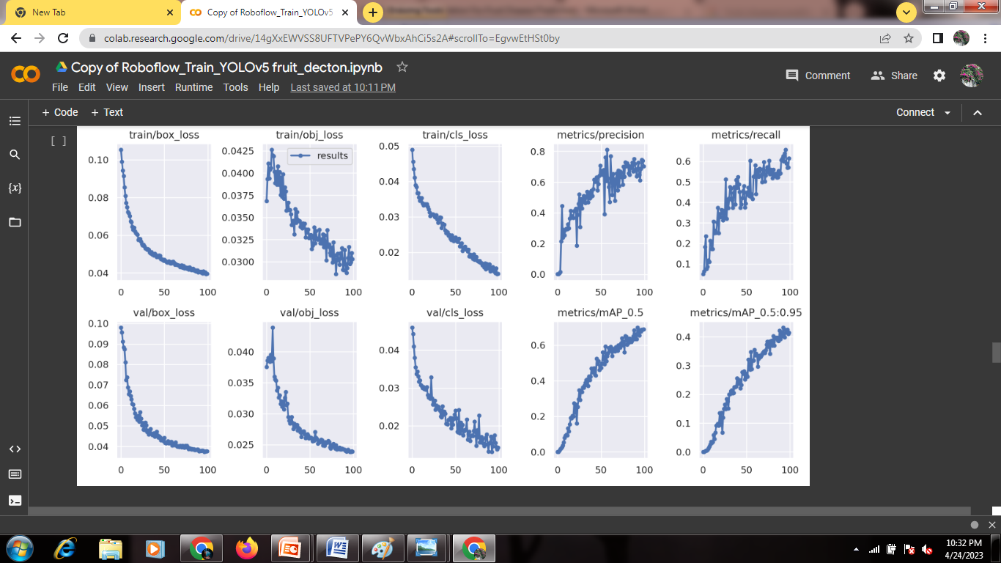

Slide 20
Continue...
Testing: Once the model is trained and evaluated, it can be used to test new images of fruits to identify and classify any diseases present.
Disease Prediction

Slide 21
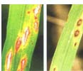
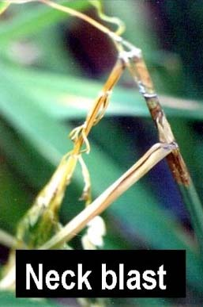
Fertilizer Recommendation
Diseases of Rice | Symptoms | Images | Recommended Fertilizers
Leaf Blast | Spindle shaped spots with grey centre and dark brown margin (Leaf blast). |  | Spray the nursery with carbendazim 500mg/L or tricyclazole 300mg/L. Spray the main field with Edifenphos 500 ml or Carbendazim 500 g or Tricyclazole 500 g or Iprobenphos (IBP) 500 ml /ha.
Node Blast | Brownish-black which is referred to as rotten neck /neck rot /panicle blast (neck blast). |  | Spray the main field with Edifenphos 500 ml or Carbendazim 500 g or Tricyclazole 500 g or Iprobenphos (IBP) 500 ml /ha.

Slide 22
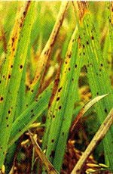
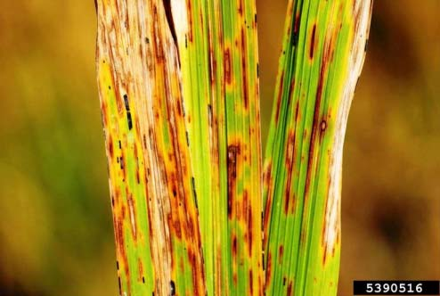
Diseases of Rice | Symptoms | Images | Recommended Fertilizers
Brown Spot | Coleoptile, leaf blade,leaf sheath, and glume, being most prominent on the leaf blade and glumes. |  | Treat the seeds with Thiram or Captan at 4 g/kg. Spray the nursery with Edifenphos 40 ml or Mancozeb 80 g for 20 cent nursery. Spray the crop in the main field with Edifenphos 500 ml or Mancozeb 2 kg/ha when grade reaches 3. If needed repeat after 15 days.
Narrow brown leaf spot | Linear brown spots mostly on leaves and also on sheaths, pedicels and glumes. |  | Spray Carbendazim 500 g or Mancozeb 2 kg/ha.

Slide 23
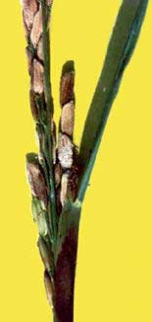
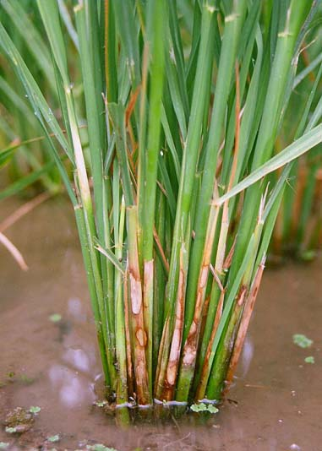
Diseases of Rice | Symptoms | Images | Recommended Fertilizers
Sheath rot | Only on the upper most leaf sheath enclosing young panicles. |  | Spray Carbendazim 500g or Edifenphos 1L or Mancozeb 2 kg/ha at boot leaf stage and 15 days later. Neem Seed Kernal Extract (NSKE) 5% or neem oil 3 % or Ipomoea or Prosopis leaf powder extract 25 Kg/ha.
Sheath blight | Initial noticed on leaf sheaths near water level. On the leaf sheath oval or elliptical or irregular greenish grey spots are formed. |  | Apply organic amendments viz., neem cake @ 150Kg/ha or FYM 12.5 tons/ha. Spray Carbendazim 500 g/ha. Foliar spray P.fluorescens at 0.2% at boot leaf stage and 10 days later.

Slide 24
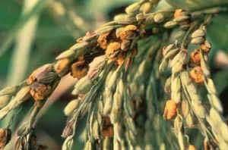
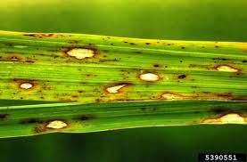
Diseases of Rice | Symptoms | Images | Recommended Fertilizers
False smut | The fungus transforms individual ovaries / grains into greenish spore balls of velvetty appearance. |  | Applying captan, captafol, fentin hydroxide, and mancozeb can be inhibited conidial germination.
Stackburn disease | Leaves and ripening grains are affected |  | Treat the seeds with Thiram or Captan or Mancozeb at 2g/kg.

Slide 25
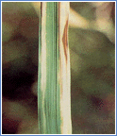
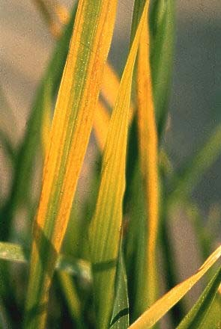
Diseases of Rice | Symptoms | Images | Recommended Fertilizes
Bacterial leaf blight | Yellow spots in the margin. |  | Spray Streptomycin sulphate and tetracycline combination 300g + Copper oxychloride 1.25 Kg/ha.
Rice Tungro Disease (RTD) | Leaves show yellow to orange discoloration. |  | Spray Phosphomidan 500 ml or Monocrotophos 1lit/ha (2 ml/litre) or Neem oil 3% or NSKE 5% to control the vector in the main field 15 and 30 days after transplanting.

Slide 26
Conclusion
This study tested the improvement of different modules on the performance of the YOLOX algorithm and verified the effectiveness of the improved model. For example, the CSP block is replaced by a self-designed C3HB block in the backbone part; the normalized attention module (NAM) is introduced in the neck and the latest SIOU loss function is embedded. The mAP, precision, and recall are improved by 4.08%, 3.64%, and 2.04%, respectively. And compared with five popular detection algorithms, SDNet has the best detection
results. SD Net also meets the requirement of real-time
monitoring.

Slide 27
Reference works
T. Ilyas, A. Khan, M. Umraiz, Y. Jeong, and H.Kim,‘‘Multiscale context aggregation for strawberry fruit recognition and disease phenotyping,’’ IEEE Access, vol. 9, pp. 124491–124504, 2021,
A. Subeesh, S. Bhole, K. Singh, N. S. Chandel, Y. A. Rajwade,
K. V. R. Rao, S. P. Kumar, and D. Jat, ‘‘Deep convolutional
neural network models for weed detection in polyhouse grown
bell peppers,’’ Artif. Intell.Agricult., vol. 6, pp. 47–54, Jan. 2022.

Slide 28
THANK YOU

